Slide 1
Data Mining: Concepts and Principles Ch. 8. Classification: Basic Concepts
Slightly Modified from the slides by Prof. Jiawei Han, UIUC CS412 Course (Introduction to Data Mining)

Slide 2
Chapter 8. Classification: Basic Concepts
Classification: Basic Concepts
Decision Tree Induction
Bayes Classification Methods
Linear Classifier
Model Evaluation and Selection
Techniques to Improve Classification Accuracy: Ensemble Methods
Additional Concepts on Classification
Summary
Notes:
2

Slide 3
Supervised vs. Unsupervised Learning (1)
Supervised learning (classification)
Supervision: The training data such as observations or measurements are accompanied by labels indicating the classes which they belong to
New data is classified based on the models built from the training set
Training Data with class label:
Model
Learning
Training
Instances
Positive
Prediction
Model
Test
Instances
Negative

Slide 4
Supervised vs. Unsupervised Learning (2)
Unsupervised learning (clustering)
The class labels of training data are unknown
Given a set of observations or measurements, establish the possible existence of classes or clusters in the data

Slide 5
Prediction Problems: Classification vs. Numeric Prediction
Classification
Predict categorical class labels (discrete or nominal)
Construct a model based on the training set and the class labels (the values in a classifying attribute) and use it in classifying new data
Numeric prediction
Model continuous-valued functions (i.e., predict unknown or missing values)
Typical applications of classification
Credit/loan approval
Medical diagnosis: if a tumor is cancerous or benign
Fraud detection: if a transaction is fraudulent
Web page categorization: which category it is

Slide 6
Classification—Model Construction, Validation and Testing
Model construction
Each sample is assumed to belong to a predefined class (shown by the class label)
The set of samples used for model construction is training set
Model: Represented as decision trees, rules, mathematical formulas, or other forms
Model Validation and Testing:
Test: Estimate accuracy of the model
The known label of test sample is compared with the classified result from the model
Accuracy: % of test set samples that are correctly classified by the model
Test set is independent of training set
Validation: If the test set is used to select or refine models, it is called validation (or development) (test) set
Model Deployment: If the accuracy is acceptable, use the model to classify new data

Slide 7
Chapter 8. Classification: Basic Concepts
Classification: Basic Concepts
Decision Tree Induction
Bayes Classification Methods
Linear Classifier
Model Evaluation and Selection
Techniques to Improve Classification Accuracy: Ensemble Methods
Additional Concepts on Classification
Summary
Notes:
7

Slide 8
Decision Tree Induction: An Example
Decision tree construction:
A top-down, recursive, divide-and-conquer process
Resulting tree:
Training data set: Who buys computer?
age?
<=30
overcast
>40
31..40
student?
Buy
credit rating?
no
yes
excellent
fair
Not-buy
Buy
Not-buy
Buy
Note: The data set is adapted from “Playing Tennis” example of R. Quinlan

Slide 9
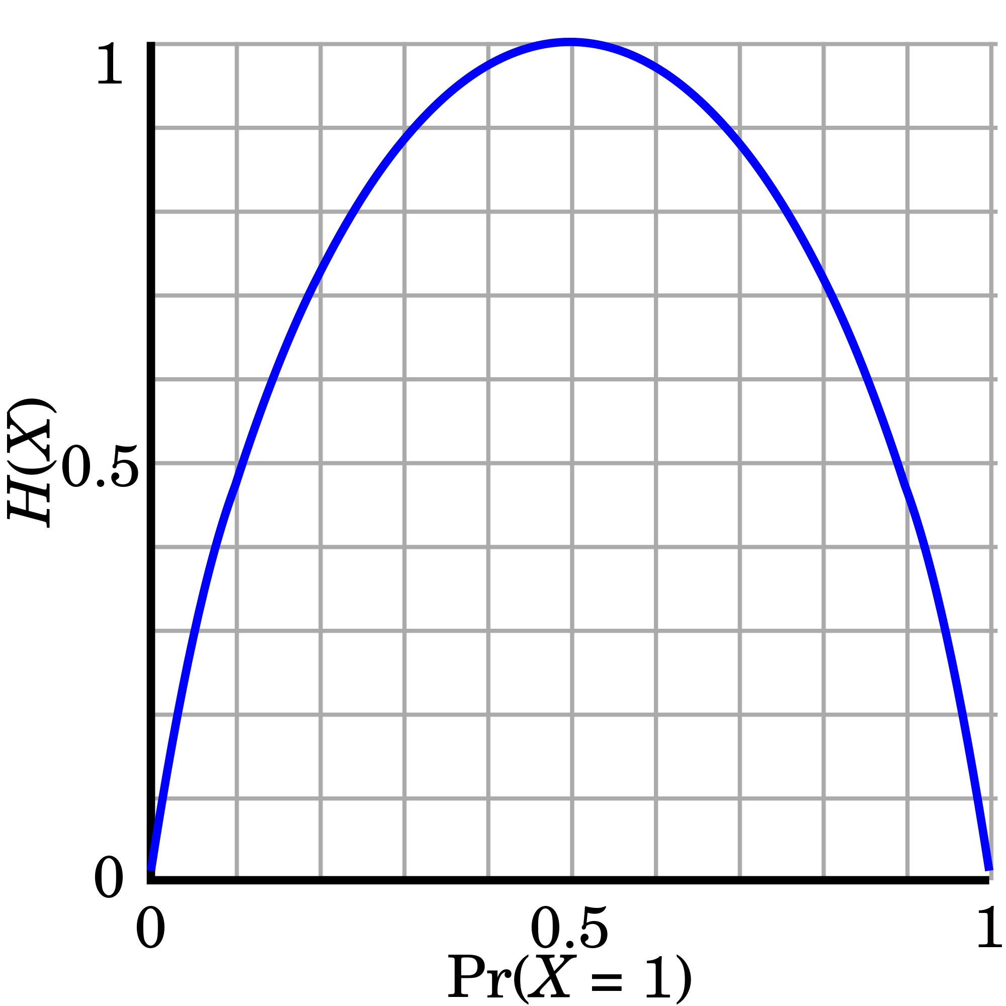
From Entropy to Info Gain: A Brief Review of Entropy
Entropy (Information Theory)
A measure of uncertainty associated with a random number
Calculation: For a discrete random variable Y taking m distinct values {y₁, y₂, …, y_{m}}
Interpretation
Higher entropy → higher uncertainty
Lower entropy → lower uncertainty
Conditional entropy
m = 2

Slide 10
Information Gain: An Attribute Selection Measure
Select the attribute with the highest information gain (used in typical decision tree induction algorithm: ID3/C4.5)
Let p_{i} be the probability that an arbitrary tuple in D belongs to class C_{i}, estimated by |C_{i, D}|/|D|
Expected information (entropy) needed to classify a tuple in D:
Information needed (after using A to split D into v partitions) to classify D:
Information gained by branching on attribute A
Notes:
I : the expected information needed to classify a given sample
E (entropy) : expected information based on the partitioning into subsets by A

Slide 11
Example: Attribute Selection with Information Gain
Class P: buys_computer = “yes”
Class N: buys_computer = “no”
means “age <=30” has 5 out of 14 samples, with 2 yes’es and 3 no’s. Hence
Similarly, we can get

Slide 12
Decision Tree Induction: Algorithm
Basic algorithm
Tree is constructed in a top-down, recursive, divide-and-conquer manner
At start, all the training examples are at the root
Examples are partitioned recursively based on selected attributes
On each node, attributes are selected based on the training examples on that node, and a heuristic or statistical measure (e.g., information gain)
Conditions for stopping partitioning
All samples for a given node belong to the same class
There are no remaining attributes for further partitioning
There are no samples left
Prediction
Majority voting is employed for classifying the leaf

Slide 13
How to Handle Continuous-Valued Attributes?
Method 1: Discretize continuous values and treat them as categorical values
E.g., age: < 20, 20..30, 30..40, 40..50, > 50
Method 2: Determine the best split point for continuous-valued attribute A
Sort the value A in increasing order:, e.g. 15, 18, 21, 22, 24, 25, 29, 31, …
Possible split point: the midpoint between each pair of adjacent values
(a_{i}+a_{i+1})/2 is the midpoint between the values of a_{i} and a_{i+1}
e.g., (15+18/2 = 16.5, 19.5, 21.5, 23, 24.5, 27, 30, …
The point with the maximum information gain for A is selected as the split-point for A
Split: Based on split point P
The set of tuples in D satisfying A ≤ P vs. those with A > P

Slide 14
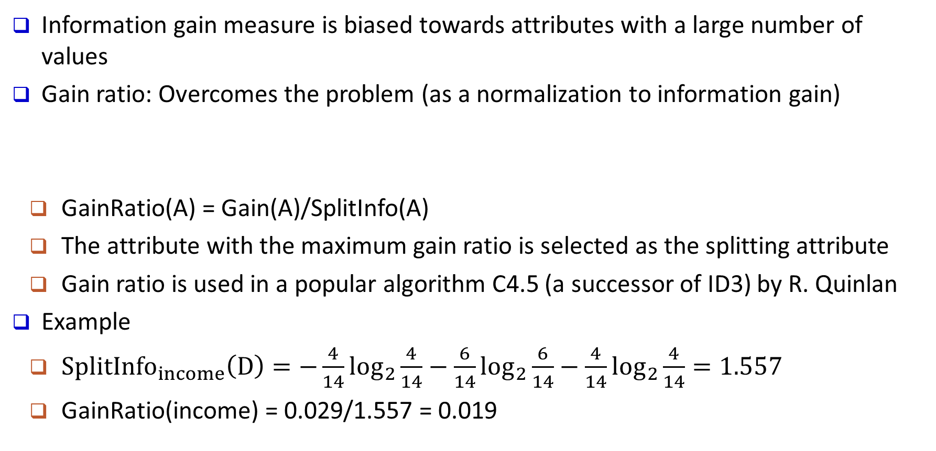
Gain Ratio: A Refined Measure for Attribute Selection
Information gain measure is biased towards attributes with a large number of values
Gain ratio: Overcomes the problem (as a normalization to information gain)
GainRatio(A) = Gain(A)/SplitInfo(A)
The attribute with the maximum gain ratio is selected as the splitting attribute
Gain ratio is used in a popular algorithm C4.5 (a successor of ID3) by R. Quinlan
Example
$SplitInfo_{income}\left(D\right)=−\frac{4}{14}\log_{2}\frac{4}{14}−\frac{6}{14}\log_{2}\frac{6}{14}−\frac{4}{14}\log_{2}\frac{4}{14}=1.557$
GainRatio(income) = 0.029/1.557 = 0.019

Slide 15
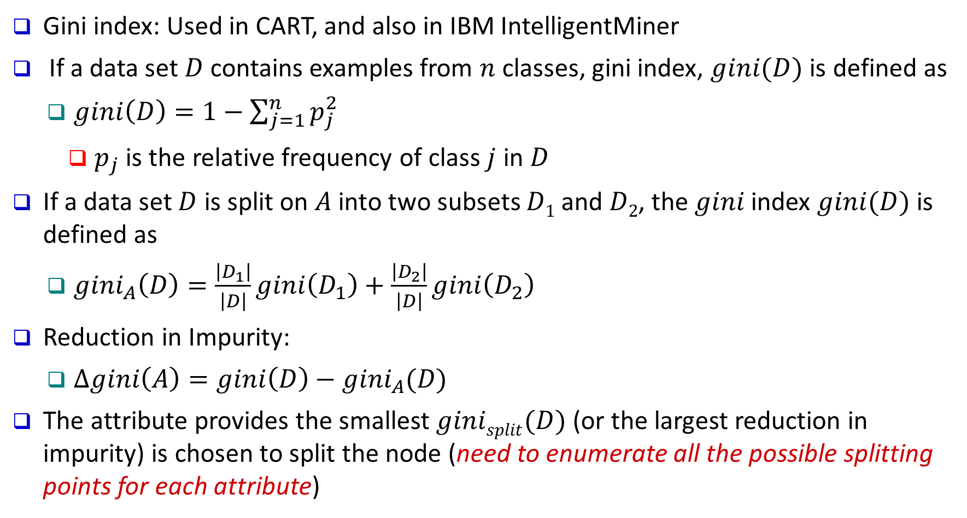
Another Measure: Gini Index
Gini index: Used in CART, and also in IBM IntelligentMiner
If a data set $D$ contains examples from $n$ classes, gini index, $gini(D)$ is defined as
$gini\left(D\right)=1−\sum_{j=1}^{n}{p_{j}^{2}}$
$p_{j}$ is the relative frequency of class $j$ in $D$
If a data set $D$ is split on $A$ into two subsets $D1$ and $D2$, the $gini$ index $gini(D)$ is defined as
$gini_{A}\left(D\right)=\frac{\left|D_{1}\right|}{\left|D\right|}gini\left(D_{1}\right)+\frac{\left|D_{2}\right|}{\left|D\right|}gini\left(D_{2}\right)$
Reduction in Impurity:
$Δgini\left(A\right)=gini\left(D\right)−gini_{A}(D)$
The attribute provides the smallest $ginisplit(D)$ (or the largest reduction in impurity) is chosen to split the node (need to enumerate all the possible splitting points for each attribute)

Slide 16
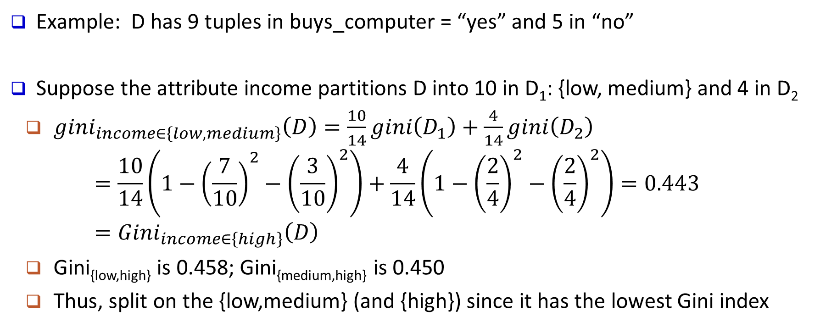
Computation of Gini Index
Example: D has 9 tuples in buys_computer = “yes” and 5 in “no”
Suppose the attribute income partitions D into 10 in D₁: {low, medium} and 4 in D₂
$gini_{income∈\left\{low, medium\right\}}\left(D\right)=\frac{10}{14}gini\left(D_{1}\right)+\frac{4}{14}gini\left(D_{2}\right)$
$$=\frac{10}{14}\left(1−{\left(\frac{7}{10}\right)}^{2}−{\left(\frac{3}{10}\right)}^{2}\right)+\frac{4}{14}\left(1−{\left(\frac{2}{4}\right)}^{2}−{\left(\frac{2}{4}\right)}^{2}\right)=0.443=Gini_{income∈\left\{high\right\}}\left(D\right)$$
Gini_{{low,high}} is 0.458; Gini_{{medium,high}} is 0.450
Thus, split on the {low,medium} (and {high}) since it has the lowest Gini index
All attributes are assumed continuous-valued
May need other tools, e.g., clustering, to get the possible split values
Can be modified for categorical attributes

Slide 17
Comparing Three Attribute Selection Measures
The three measures, in general, return good results but
Information gain:
biased towards multivalued attributes
Gain ratio:
tends to prefer unbalanced splits in which one partition is much smaller than the others
Gini index:
biased to multivalued attributes
has difficulty when # of classes is large
tends to favor tests that result in equal-sized partitions and purity in both partitions

Slide 18
Other Attribute Selection Measures
Minimal Description Length (MDL) principle
Philosophy: The simplest solution is preferred
The best tree as the one that requires the fewest # of bits to both (1) encode the tree, and (2) encode the exceptions to the tree
CHAID: a popular decision tree algorithm, measure based on χ² test for independence
Multivariate splits (partition based on multiple variable combinations)
CART: finds multivariate splits based on a linear combination of attributes
There are many other measures proposed in research and applications
E.g., G-statistics, C-SEP
Which attribute selection measure is the best?
Most give good results, none is significantly superior than others

Slide 19
Overfitting and Tree Pruning
Overfitting: An induced tree may overfit the training data
Too many branches, some may reflect anomalies due to noise or outliers
Poor accuracy for unseen samples
Two approaches to avoid overfitting
Prepruning: Halt tree construction early ̵ do not split a node if this would result in the goodness measure falling below a threshold
Difficult to choose an appropriate threshold
Postpruning: Remove branches from a “fully grown” tree—get a sequence of progressively pruned trees
Use a set of data different from the training data to decide which is the “best pruned tree”

Slide 20
Classification in Large Databases
Classification—a classical problem extensively studied by statisticians and machine learning researchers
Scalability: Classifying data sets with millions of examples and hundreds of attributes with reasonable speed
Why is decision tree induction popular?
Relatively fast learning speed
Convertible to simple and easy to understand classification rules
Easy to be adapted to database system implementations (e.g., using SQL)
Comparable classification accuracy with other methods
RainForest (VLDB’98 — Gehrke, Ramakrishnan & Ganti)
Builds an AVC-list (attribute, value, class label)

Slide 21
RainForest: A Scalable Classification Framework
The criteria that determine the quality of the tree can be computed separately
Builds an AVC-list: AVC (Attribute, Value, Class_label)
AVC-set (of an attribute X )
Projection of training dataset onto the attribute X and class label where counts of individual class label are aggregated
AVC-set on Age
AVC-set on Income
AVC-group (of a node n )
Set of AVC-sets of all predictor attributes at the node n
Age | Buy_Computer
 | yes | no
<=30 | 2 | 3
31..40 | 4 | 0
>40 | 3 | 2
income | Buy_Computer
 | yes | no
high | 2 | 2
medium | 4 | 2
low | 3 | 1
AVC-set on Student
AVC-set on Credit_Rating
student | Buy_Computer
 | yes | no
yes | 6 | 1
no | 3 | 4
Credit rating | Buy_Computer
 | yes | no
fair | 6 | 2
excellent | 3 | 3
The Training Data
Its AVC Sets

Slide 22
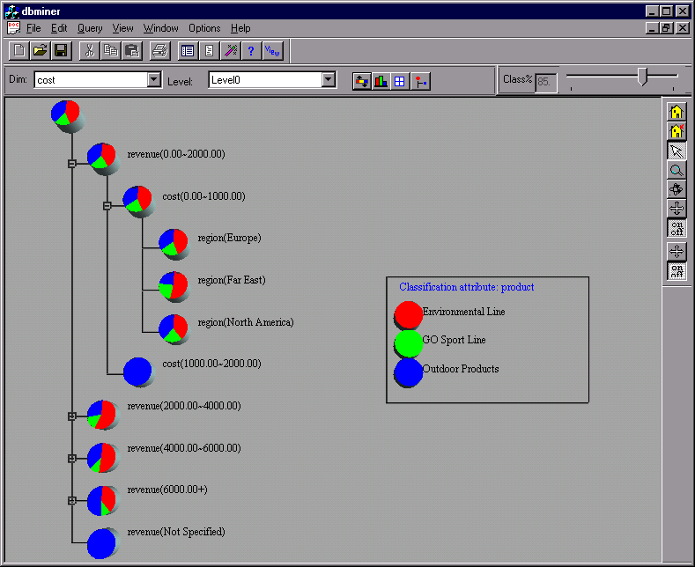
Presentation of Classification Results

Slide 23
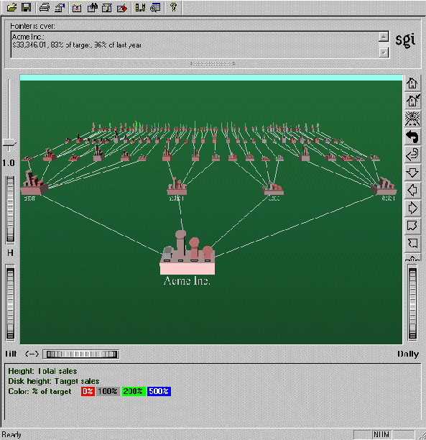
Visualization of a Decision Tree (in SGI/MineSet 3.0)

Slide 24
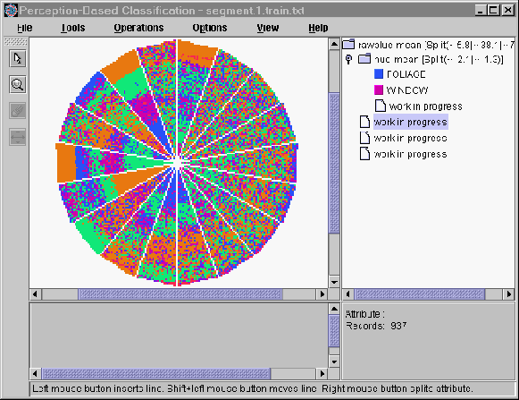
Interactive Visual Mining by Perception-Based Classification (PBC)
Perception-based classifier (PCB): developed at Univ. of Munich (1999)
One color represents one class label
One pie represents one attribute (or variable)
The pie with random spread implies weak classification power
The pie with clearly partitioned color strips implies good classification power
One can select a good attribute and regenerate new pie charts for classification at the subsequent levels

Slide 25
Chapter 8. Classification: Basic Concepts
Classification: Basic Concepts
Decision Tree Induction
Bayes Classification Methods
Linear Classifier
Model Evaluation and Selection
Techniques to Improve Classification Accuracy: Ensemble Methods
Additional Concepts on Classification
Summary
Notes:
25

Slide 26
What Is Bayesian Classification?
A statistical classifier
Perform probabilistic prediction (i.e., predict class membership probabilities)
Foundation—Based on Bayes’ Theorem
Performance
A simple Bayesian classifier, naïve Bayesian classifier, has comparable performance with decision tree and selected neural network classifiers
Incremental
Each training example can incrementally increase/decrease the probability that a hypothesis is correct—prior knowledge can be combined with observed data
Theoretical Standard
Even when Bayesian methods are computationally intractable, they can provide a standard of optimal decision making against which other methods can be measured

Slide 27
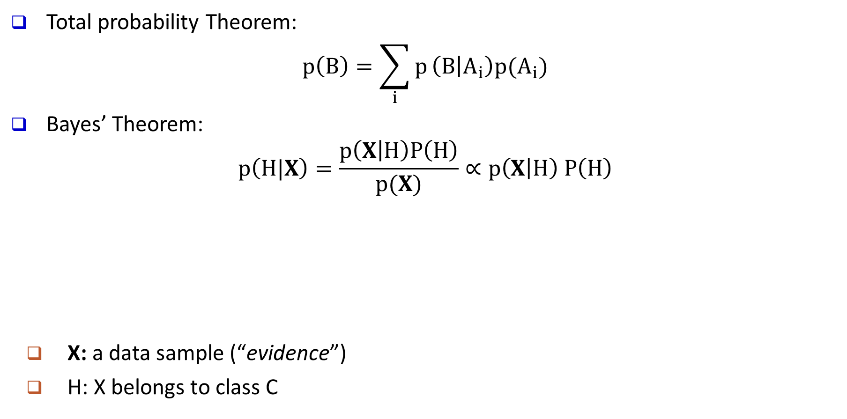
Bayes’ Theorem: Basics
Total probability Theorem:
$$p\left(B\right)=\sum_{i}{p}\left(B | A_{i}\right)p(A_{i})$$
Bayes’ Theorem:
$$p\left(H|X\right)=\frac{p\left(X | H\right)P\left(H\right)}{p(X)}∝p\left(X | H\right) P\left(H\right)$$
X: a data sample (“evidence”)
H: X belongs to class C
posteriori probability
likelihood
prior probability
What we should choose
What we just see
What we knew previously
Prediction can be done based on Bayes’ Theorem:
Classification is to derive the maximum posteriori

Slide 28
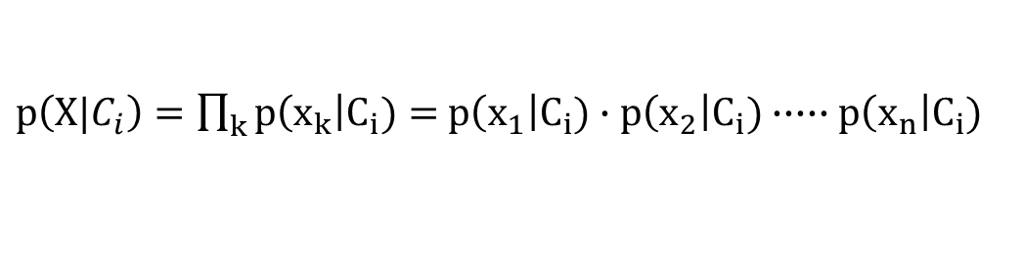
Naïve Bayes Classifier: Making a Naïve Assumption
Practical difficulty of Naïve Bayes inference: It requires initial knowledge of many probabilities, which may not be available or involving significant computational cost
A Naïve Special Case
Make an additional assumption to simplify the model, but achieve comparable performance.
Only need to count the class distribution w.r.t. features
attributes are conditionally independent
(i.e., no dependence relation between attributes)
$p\left(X|C_{i}\right)=\prod_{k}{p\left(x_{k}\right|C_{i})}=$ $p\left(x_{1}\right|C_{i})∙p\left(x_{2}\right|C_{i})∙∙∙∙∙p\left(x_{n}\right|C_{i})$

Slide 29
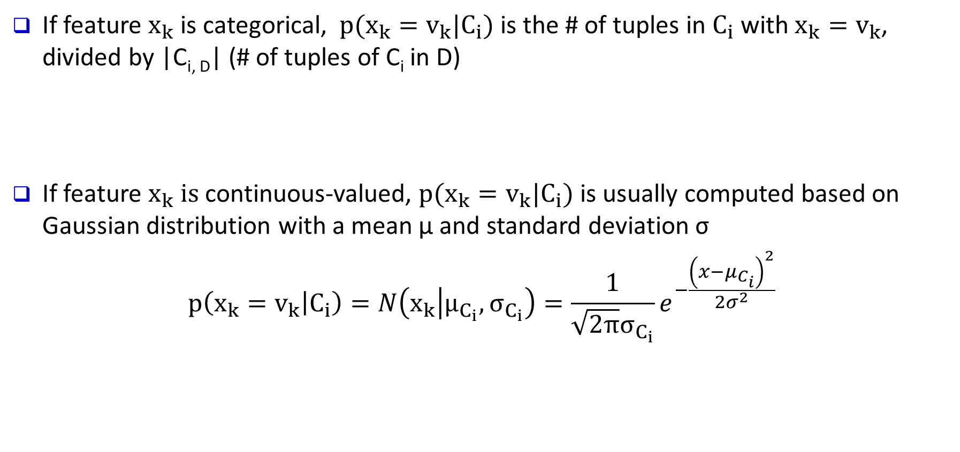
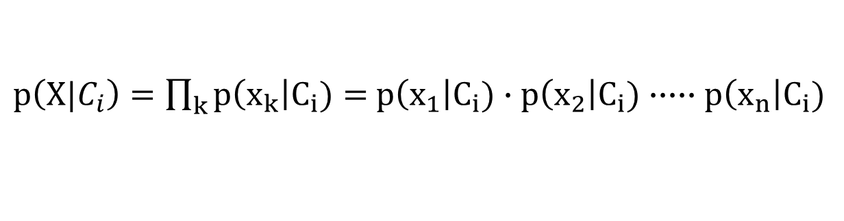
Naïve Bayes Classifier: Categorical vs. Continuous Valued Features
If feature $x_{k}$ is categorical, $p(x_{k}=v_{k}|C_{i})$ is the # of tuples in $C_{i}$ with $x_{k}=v_{k}$, divided by |C_{i, D}| (# of tuples of C_{i} in D)
If feature $x_{k} is$continuous-valued, $p(x_{k}=v_{k}|C_{i})$ is usually computed based on Gaussian distribution with a mean μ and standard deviation σ
$$p\left(x_{k}=v_{k} | C_{i}\right)=N\left(x_{k} | μ_{C_{i}}, σ_{C_{i}}\right)=\frac{1}{\sqrt{2π}σ_{C_{i}}}e^{−\frac{{\left(x−μ_{C_{i}}\right)}^{2}}{2σ^{2}}}$$
$p\left(X|C_{i}\right)=\prod_{k}{p\left(x_{k}\right|C_{i})}=$ $p\left(x_{1}\right|C_{i})∙p\left(x_{2}\right|C_{i})∙∙∙∙∙p\left(x_{n}\right|C_{i})$

Slide 30
Naïve Bayes Classifier: Training Dataset
Class:
C1:buys_computer = ‘yes’
C2:buys_computer = ‘no’
Data to be classified:
X = (age <=30, Income = medium,
Student = yes, Credit_rating = Fair)

Slide 31
Naïve Bayes Classifier: An Example
P(C_{i}): P(buys_computer = “yes”) = 9/14 = 0.643
P(buys_computer = “no”) = 5/14= 0.357
Compute P(X|C_{i}) for each class
P(age = “<=30”|buys_computer = “yes”) = 2/9 = 0.222
P(age = “<= 30”|buys_computer = “no”) = 3/5 = 0.6
P(income = “medium” | buys_computer = “yes”) = 4/9 = 0.444
P(income = “medium” | buys_computer = “no”) = 2/5 = 0.4
P(student = “yes” | buys_computer = “yes) = 6/9 = 0.667
P(student = “yes” | buys_computer = “no”) = 1/5 = 0.2
P(credit_rating = “fair” | buys_computer = “yes”) = 6/9 = 0.667
P(credit_rating = “fair” | buys_computer = “no”) = 2/5 = 0.4
X = (age <= 30 , income = medium, student = yes, credit_rating = fair)
P(X|C_{i}) : P(X|buys_computer = “yes”) = 0.222 x 0.444 x 0.667 x 0.667 = 0.044
P(X|buys_computer = “no”) = 0.6 x 0.4 x 0.2 x 0.4 = 0.019
P(X|C_{i})*P(C_{i}) : P(X|buys_computer = “yes”) * P(buys_computer = “yes”) = 0.028
P(X|buys_computer = “no”) * P(buys_computer = “no”) = 0.007
Therefore, X belongs to class (“buys_computer = yes”)

Slide 32
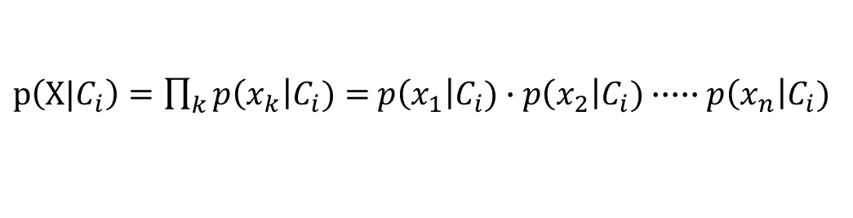
Avoiding the Zero-Probability Problem
Naïve Bayesian prediction requires each conditional probability be non-zero
Otherwise, the predicted probability will be zero
Example. Suppose a dataset with 1000 tuples:
income = low (0), income= medium (990), and income = high (10)
Use Laplacian correction (or Laplacian estimator)
Adding 1 to each case
Prob(income = low) = 1/(1000 + 3)
Prob(income = medium) = (990 + 1)/(1000 + 3)
Prob(income = high) = (10 + 1)/(1000 + 3)
The “corrected” probability estimates are close to their “uncorrected” counterparts
$p\left(X|C_{i}\right)=\prod_{k}{p\left(x_{k}\right|C_{i})}=$ $p\left(x_{1}\right|C_{i})∙p\left(x_{2}\right|C_{i})∙∙∙∙∙p\left(x_{n}\right|C_{i})$

Slide 33
Naïve Bayes Classifier: Strength vs. Weakness
Strength
Easy to implement
Good results obtained in most of the cases
Weakness
Assumption: attributes conditional independence, therefore loss of accuracy
Practically, dependencies exist among variables
E.g., Patients: Profile: age, family history, etc.
Symptoms: fever, cough etc.
Disease: lung cancer, diabetes, etc.
Dependencies among these cannot be modeled by Naïve Bayes Classifier
How to deal with these dependencies?
Use Bayesian Belief Networks (to be covered in the next chapter)

Slide 34
Chapter 8. Classification: Basic Concepts
Classification: Basic Concepts
Decision Tree Induction
Bayes Classification Methods
Linear Classifier
Model Evaluation and Selection
Techniques to Improve Classification Accuracy: Ensemble Methods
Additional Concepts on Classification
Summary
Notes:
34

Slide 35
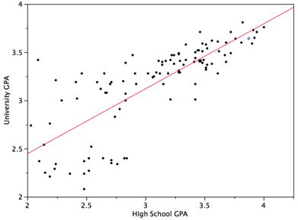
Linear Regression vs. Linear Classifier
Linear regression
Data modeled to fit a straight line
Linear equation: Y = w X + b
Often uses the least-square method to fit the line
Used to predict continuous values
Linear Classifier
Built a classification model using a straight line
Used for (categorical data) binary classification
x
x
x
x
x
x
x
x
x
o
o
x
o
o
o
o
o
o
o
o
o
o
o

Slide 36
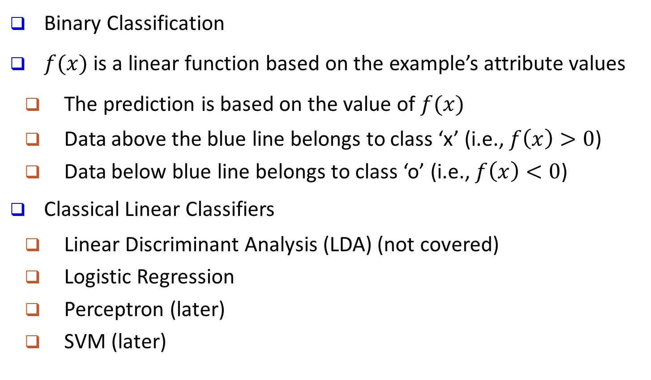
Linear Classifier: General Ideas
Binary Classification
$f(x)$ is a linear function based on the example’s attribute values
The prediction is based on the value of $f(x)$
Data above the blue line belongs to class ‘x’ (i.e., $f\left(x\right)>0$)
Data below blue line belongs to class ‘o’ (i.e., $f\left(x\right)<0$)
Classical Linear Classifiers
Linear Discriminant Analysis (LDA) (not covered)
Logistic Regression
Perceptron (later)
SVM (later)
x
x
x
x
x
x
x
x
x
o
o
x
o
o
o
o
o
o
o
o
o
o
o

Slide 37
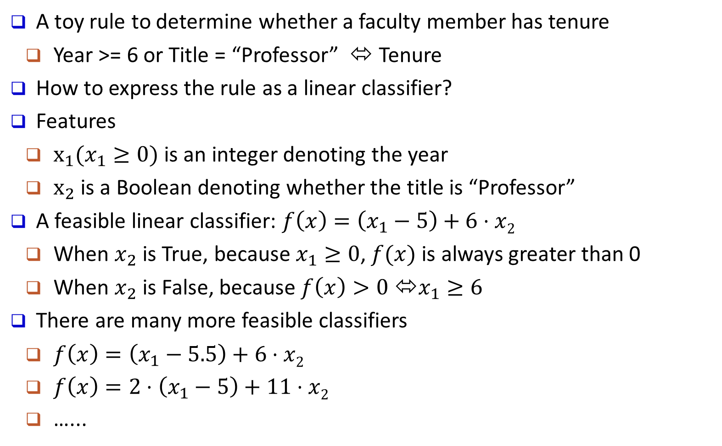
Linear Classifier: An Example
A toy rule to determine whether a faculty member has tenure
Year >= 6 or Title = “Professor” ⬄ Tenure
How to express the rule as a linear classifier?
Features
$x_{1}(x_{1}≥0)$ is an integer denoting the year
$x_{2}$ is a Boolean denoting whether the title is “Professor”
A feasible linear classifier: $f\left(x\right)=\left(x_{1}−5\right)+6⋅x2$
When $x_{2}$ is True, because $x_{1}≥0$, $f(x)$ is always greater than 0
When $x_{2}$ is False, because $f\left(x\right)>0$ ⬄$x_{1}≥6$
There are many more feasible classifiers
$f\left(x\right)=\left(x_{1}−5.5\right)+6⋅x2$
$f\left(x\right)=2⋅\left(x_{1}−5\right)+11⋅x2$
…...

Slide 38
Key Question: Which Line Is Better?
There might be many feasible linear functions
Both H1 and H2 will work
Which one is better?
H2 looks “better” in the sense that it is also furthest from both groups
We will introduce more in the SVM section

Slide 39
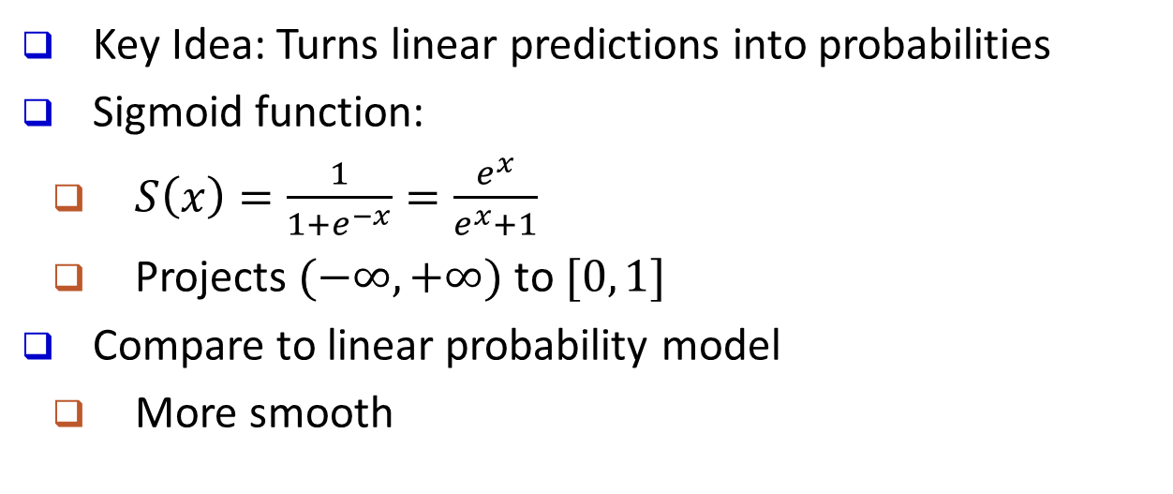
Logistic Regression: General Ideas
Key Idea: Turns linear predictions into probabilities
Sigmoid function:
$S\left(x\right)=\frac{1}{1+e^{−x}}=\frac{e^{x}}{e^{x}+1}$
Projects $(−∞, +∞)$ to $[0, 1]$
Compare to linear probability model
More smooth
Logistic Regression Model
Linear Probability Model

Slide 40
Logistic Regression: An Example
Suppose we only consider the year as feature
1 (Tenured)
year
6

Slide 41
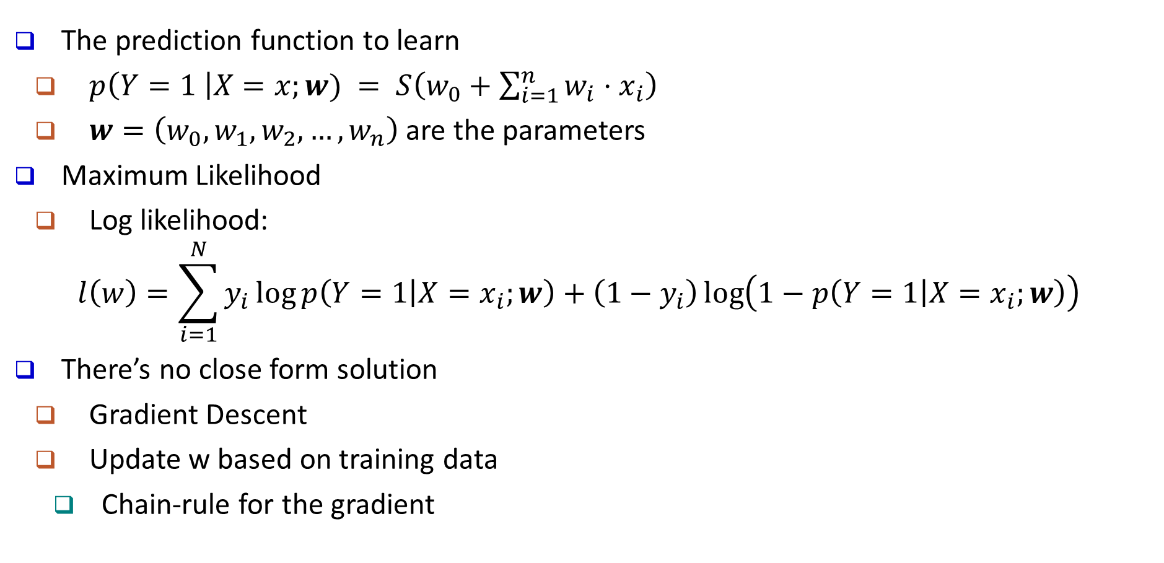
Logistic Regression: Maximum Likelihood
The prediction function to learn
$p\left(Y=1 \right|X=x;w) = S\left(w_{0}+\sum_{i=1}^{n}{w_{i}⋅x_{i}}\right)$
$w=\left(w_{0}, w_{1}, w_{2},…,w_{n}\right)$ are the parameters
Maximum Likelihood
Log likelihood:
$$l\left(w\right)=\sum_{i=1}^{N}{y_{i}}\log{p\left(Y=1 | X=x_{i};w\right)}+\left(1−y_{i}\right)\log\left(1−p\left(Y=1 | X=x_{i};w\right)\right)$$
There’s no close form solution
Gradient Descent
Update w based on training data
Chain-rule for the gradient

Slide 42
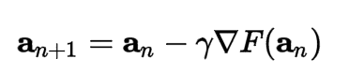
Gradient Descent
Gradient Descent is an iterative optimization algorithm for finding the minimum of a function (e.g., the negative log likelihood)
For a function F(x) at a point a, F(x) decreases fastest if we go in the direction of the negative gradient of a
When the gradient is zero, we arrive at the local minimum

Slide 43
Generative vs. Discriminative Classifiers
X: observed variables (features)
Y: target variables (class labels)
A generative classifier models p(Y, X)
It models how the data was "generated“? "what is the likelihood this or that class generated this instance?" and pick the one with higher probability
Naïve Bayes
Bayesian Networks
A discriminative classifier models p(Y|X)
It uses the data to create a decision boundary
Logistic Regression
Support Vector Machines

Slide 44
Further Comments on Discriminative Classifiers
Strength
Prediction accuracy is generally high
As compared to generative models
Robust, works when training examples contain errors
Fast evaluation of the learned target function
Comparing to (covered in future) Bayesian networks (which are normally slow)
Criticism
Long training time
Difficult to understand the learned function (weights)
Bayesian networks can be used easily for pattern discovery
Not easy to incorporate domain knowledge
Easy in the form of priors on the data or distributions
Notes:
44

Slide 45
Chapter 8. Classification: Basic Concepts
Classification: Basic Concepts
Decision Tree Induction
Bayes Classification Methods
Linear Classifier
Model Evaluation and Selection
Techniques to Improve Classification Accuracy: Ensemble Methods
Additional Concepts on Classification
Summary
Notes:
45

Slide 46
Model Evaluation and Selection
Evaluation metrics
How can we measure accuracy?
Other metrics to consider?
Use validation test set of class-labeled tuples instead of training set when assessing accuracy
Methods for estimating a classifier’s accuracy
Holdout method
Cross-validation
Bootstrap
Comparing classifiers:
ROC Curves

Slide 47
Classifier Evaluation Metrics: Confusion Matrix
Confusion Matrix:
In a confusion matrix w. m classes, CM_{i,j} indicates # of tuples in class i that were labeled by the classifier as class j
May have extra rows/columns to provide totals
Example of Confusion Matrix:
Actual class\Predicted class | C₁ | ¬ C₁
C₁ | True Positives (TP) | False Negatives (FN)
¬ C₁ | False Positives (FP) | True Negatives (TN)
Actual class\Predicted class | buy_computer = yes | buy_computer = no | Total
buy_computer = yes | 6954 | 46 | 7000
buy_computer = no | 412 | 2588 | 3000
Total | 7366 | 2634 | 10000

Slide 48
Classifier Evaluation Metrics: Accuracy, Error Rate, Sensitivity and Specificity
A\P | C | ¬C
C | TP | FN | P
¬C | FP | TN | N
 | P’ | N’ | All
Class imbalance problem
One class may be rare
E.g., fraud, or HIV-positive
Significant majority of the negative class and minority of the positive class
Measures handle the class imbalance problem
Sensitivity (recall): True positive recognition rate
Sensitivity = TP/P
Specificity: True negative recognition rate
Specificity = TN/N
Classifier accuracy, or recognition rate
Percentage of test set tuples that are correctly classified
Accuracy = (TP + TN)/All
Error rate: 1 – accuracy, or
Error rate = (FP + FN)/All

Slide 49
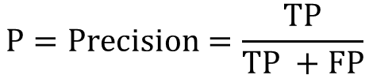
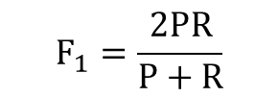
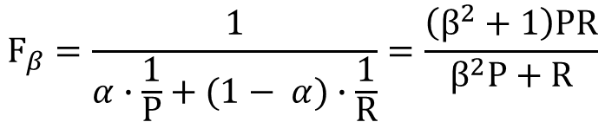
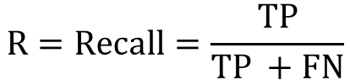
Classifier Evaluation Metrics: Precision and Recall, and F-measures
Precision: Exactness: what % of tuples that the classifier labeled as positive are actually positive?
Recall: Completeness: what % of positive tuples did the classifier label as positive?
Range: [0, 1]
The “inverse” relationship between precision & recall
F measure (or F-score): harmonic mean of precision and recall
In general, it is the weighted measure of precision & recall
F1-measure (balanced F-measure)
That is, when β = 1,
$$P=Precision=\frac{TP}{TP +FP}$$
$$R=Recall=\frac{TP}{TP +FN}$$
$$F_{β}=\frac{1}{α∙\frac{1}{P}+(1− α)∙\frac{1}{R}}=\frac{\left(β^{2}+1\right)PR}{β^{2}P+R}$$
Assigning β times as much weight to recall as to precision)
$$F_{1}=\frac{2PR}{P+R}$$

Slide 50
Classifier Evaluation Metrics: Example
Use the same confusion matrix, calculate the measure just introduced
Sensitivity = TP/P = 90/300 = 30%
Specificity = TN/N = 9560/9700 = 98.56%
Accuracy = (TP + TN)/All = (90+9560)/10000 = 96.50%
Error rate = (FP + FN)/All = (140 + 210)/10000 = 3.50%
Precision = TP/(TP + FP) = 90/(90 + 140) = 90/230 = 39.13%
Recall = TP/ (TP + FN) = 90/(90 + 210) = 90/300 = 30.00%
F1 = 2 P × R /(P + R) = 2 × 39.13% × 30.00%/(39.13% + 30%) = 33.96%
Actual Class\Predicted class | cancer = yes | cancer = no | Total | Recognition(%)
cancer = yes | 90 | 210 | 300 | 30.00 (sensitivity)
cancer = no | 140 | 9560 | 9700 | 98.56 (specificity)
Total | 230 | 9770 | 10000 | 96.50 (accuracy)

Slide 51
Classifier Evaluation: Holdout & Cross-Validation
Holdout method
Given data is randomly partitioned into two independent sets
Training set (e.g., 2/3) for model construction
Test set (e.g., 1/3) for accuracy estimation
Repeated random sub-sampling validation: a variation of holdout
Repeat holdout k times, accuracy = avg. of the accuracies obtained
Cross-validation (k-fold, where k = 10 is most popular)
Randomly partition the data into k mutually exclusive subsets, each approximately equal size
At i-th iteration, use D_{i} as test set and others as training set
Leave-one-out: k folds where k = # of tuples, for small sized data
*Stratified cross-validation*: folds are stratified so that class distribution, in each fold is approximately the same as that in the initial data

Slide 52
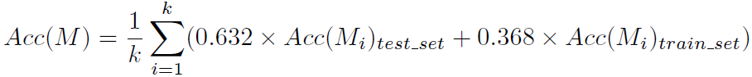
Classifier Evaluation: Bootstrap
Bootstrap
Works well with small data sets
Samples the given training tuples uniformly with replacement
Each time a tuple is selected, it is equally likely to be selected again and re-added to the training set
Several bootstrap methods, and a common one is .632 bootstrap
A data set with d tuples is sampled d times, with replacement, resulting in a training set of d samples. The data tuples that did not make it into the training set end up forming the test set. About 63.2% of the original data end up in the bootstrap, and the remaining 36.8% form the test set (since (1 – 1/d)^{d} ≈ e⁻¹ = 0.368)
Repeat the sampling procedure k times, overall accuracy of the model:

Slide 53
Model Selection: ROC Curves
ROC (Receiver Operating Characteristics) curves: for visual comparison of classification models
Originated from signal detection theory
Shows the trade-off between the true positive rate and the false positive rate
The area under the ROC curve (AUC: Area Under Curve) is a measure of the accuracy of the model
Rank the test tuples in decreasing order: the one that is most likely to belong to the positive class appears at the top of the list
The closer to the diagonal line (i.e., the closer the area is to 0.5), the less accurate is the model
Vertical axis represents the true positive rate
Horizontal axis rep. the false positive rate
The plot also shows a diagonal line
A model with perfect accuracy will have an area of 1.0

Slide 54
Issues Affecting Model Selection
Accuracy
classifier accuracy: predicting class label
Speed
time to construct the model (training time)
time to use the model (classification/prediction time)
Robustness: handling noise and missing values
Scalability: efficiency in disk-resident databases
Interpretability
understanding and insight provided by the model
Other measures, e.g., goodness of rules, such as decision tree size or compactness of classification rules
Notes:
54

Slide 55
Chapter 8. Classification: Basic Concepts
Classification: Basic Concepts
Decision Tree Induction
Bayes Classification Methods
Linear Classifier
Model Evaluation and Selection
Techniques to Improve Classification Accuracy: Ensemble Methods
Additional Concepts on Classification
Summary
Notes:
55

Slide 56
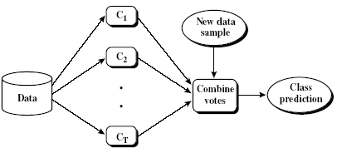
Ensemble Methods: Increasing the Accuracy
Ensemble methods
Use a combination of models to increase accuracy
Combine a series of k learned models, M₁, M₂, …, M_{k}, with the aim of creating an improved model M*
Popular ensemble methods
Bagging: Trains each model using a subset of the training set, and models learned in parallel
Boosting: Trains each new model instance to emphasize the training instances that previous models mis-classified, and models learned in order

Slide 57
Bagging: Bootstrap Aggregation
Analogy: Diagnosis based on multiple doctors’ majority vote
Training
Given a set D of d tuples, at each iteration i, a training set D_{i} of d tuples is sampled with replacement from D (i.e., bootstrap)
A classifier model M_{i} is learned for each training set D_{i}
Classification: classify an unknown sample X
Each classifier M_{i} returns its class prediction
The bagged classifier M* counts the votes and assigns the class with the most votes to X
Prediction: It can be applied to the prediction of continuous values by taking the average value of each prediction for a given test tuple
Accuracy: Improved accuracy in prediction
Often significantly better than a single classifier derived from D
For noise data: Not considerably worse, more robust

Slide 58
Random Forest: Basic Concepts
Random Forest (first proposed by L. Breiman in 2001)
A variation of bagging for decision trees
Data bagging
Use a subset of training data by sampling with replacement for each tree
Feature bagging
At each node use a random selection of attributes as candidates and split by the best attribute among them
Compared to original bagging, increases the diversity among generated trees
During classification, each tree votes and the most popular class is returned

Slide 59
Random Forest
Two Methods to construct Random Forest:
Forest-RI (random input selection): Randomly select, at each node, F attributes as candidates for the split at the node. The CART methodology is used to grow the trees to maximum size
Forest-RC (random linear combinations): Creates new attributes (or features) that are a linear combination of the existing attributes (reduces the correlation between individual classifiers)
Comparable in accuracy to Adaboost, but more robust to errors and outliers
Insensitive to the number of attributes selected for consideration at each split, and faster than typical bagging or boosting

Slide 60
Boosting
Analogy: Consult several doctors, based on a combination of weighted diagnoses—weight assigned based on the previous diagnosis accuracy
How boosting works?
Weights are assigned to each training tuple
A series of k classifiers is iteratively learned
After a classifier M_{i} is learned, the weights are updated to allow the subsequent classifier, M_{i+1}, to pay more attention to the training tuples that were misclassified by M_{i}
The final M* combines the votes of each individual classifier, where the weight of each classifier's vote is a function of its accuracy
Boosting algorithm can be extended for numeric prediction
Comparing with bagging: Boosting tends to have greater accuracy, but it also risks overfitting the model to misclassified data

Slide 61
Adaboost (Freund and Schapire, 1997)
Given a set of d class-labeled tuples, (X₁, y₁), …, (X_{d}, y_{d})
Initially, all the weights of tuples are set the same (1/d)
Generate k classifiers in k rounds. At round i,
Tuples from D are sampled (with replacement) to form a training set D_{i} of the same size
Each tuple’s chance of being selected is based on its weight
A classification model M_{i} is derived from D_{i}
Its error rate is calculated using D_{i} as a test set
If a tuple is misclassified, its weight is increased; otherwise, it is decreased
Error rate: err(X_{j}) is the misclassification error of tuple X_{j}. Classifier M_{i} error rate is the sum of the weights of the misclassified tuples:
The weight of classifier M_{i}’s vote is

Slide 62
Classification of Class-Imbalanced Data Sets
Class-imbalance problem: Rare positive examples but numerous negative ones
E.g., medical diagnosis, fraud transaction, accident (oil-spill), and product fault
Traditional methods assume a balanced distribution of classes and equal error costs: not suitable for class-imbalanced data
x
x
x
x
x
Typical methods on imbalanced data in two-class classification
Oversampling: Re-sampling of data from positive class
Under-sampling: Randomly eliminate tuples from negative class
Threshold-moving: Move the decision threshold, t, so that the rare class tuples are easier to classify, and hence, less chance of costly false negative errors
Ensemble techniques: Ensemble multiple classifiers introduced above
Still difficult for class imbalance problem on multiclass tasks
x
x
x
x
x
x
x
x
x
x
x
x
o
x
x
x
o
o
x
x
x
x
o
x
x
x

Slide 63
Classifying Data Streams with Skewed Distribution
Biased Sampling
………
?
………
S₁
S₂
S₁
Ensemble
S_{m}
S₂
S_{m}
S_{m+1}
Classification Model
………
?
S_{m} as training data? Two few positive examples!
J. Gao, et al., “A General Framework for Mining Concept-Drifting Data Streams with Skewed Distributions”, SDM’07
C₁
C₂
C_{k}
Classify data stream with skewed distribution (i.e., rare events)
Biased sampling: Save only the positive examples in the streams
Ensemble: Partition negative examples of S_{m} into k portions to build k classifiers
Effectively reduce classification errors on the minority class

Slide 64
Chapter 8. Classification: Basic Concepts
Classification: Basic Concepts
Decision Tree Induction
Bayes Classification Methods
Linear Classifier
Model Evaluation and Selection
Techniques to Improve Classification Accuracy: Ensemble Methods
Additional Concepts on Classification
Summary
Notes:
64

Slide 65
Multiclass Classification
Classification involving more than two classes (i.e., > 2 Classes)
Methodology: Reducing the multi-class problem into multiple binary problems
Method 1. One-vs.-rest (or one-vs.-all)
Given m classes, train m classifiers: one for each class
Classifier j: treat tuples in class j as positive & all the rest as negative
To classify a tuple X, the set of classifiers vote as an ensemble
Method 2. one-vs.-one (or all-vs.-all): Learn a classifier for each pair of classes
Given m classes, construct m(m − 1)/2 binary classifiers
A classifier is trained using tuples of the two classes
To classify a tuple X, each classifier votes
X is assigned to the class with maximal vote
Comparison: One-vs.-one tends to perform better than one-vs.-rest
Many new algorithms have been developed to go beyond binary classifier method

Slide 66
Semi-Supervised Classification
Semi-supervised: Uses labeled and unlabeled data to build a classifier
Self-training
Build a classifier using the labeled data
Use it to label the unlabeled data, and those with the most confident label prediction are added to the set of labeled data
Repeat the above process
Adv.: easy to understand; Disadv.: may reinforce errors
Co-training: Use two or more classifiers to teach each other
Each learner uses a mutually independent set of features of each tuple to train a good classifier, say f₁ and f₂
Then f₁ and f₂ are used to predict the class label for unlabeled data X
Teach each other: The tuple having the most confident prediction from f₁ is added to the set of labeled data for f₂ & vice versa
Other methods include joint probability distribution of features and labels
+
unlabeled
labeled
̶

Slide 67
Active Learning
A special case of semi-supervised learning
Unlabeled data: Abundant
Class labels are expensive to obtain
Active learner: Interactively query teachers (oracle) for labels
Pool-based approach: Uses a pool of unlabeled data
L: a small subset of D is labeled, U: a pool of unlabeled data in D
Use a query function to carefully select one or more tuples from U and request labels from an oracle (a human annotator)
The newly labeled samples are added to L, and learn a model
Goal: Achieve high accuracy using as few labeled data as possible
Evaluated using learning curves: Accuracy as a function of the number of instances queried (# of tuples to be queried should be small)
A lot of algorithms have been developed for active learning

Slide 68
Transfer Learning: Conceptual Framework
Transfer learning: Extract knowledge from one or more source tasks (e.g., recognizing cars) and apply the knowledge to a target task (e.g., recognizing trucks)
Traditional learning: Build a new classifier for each new task
Transfer learning: Build new classifier by applying existing knowledge learned from source tasks
Many algorithms are developed, applied to text classification, spam filtering, etc.
Traditional Learning Framework
Transfer Learning Framework

Slide 69
Weak Supervision: A New Programming Paradigm for Machine Learning
Overcome the training data bottleneck
Leverage higher-level and/or noisier input from experts
Exploring weak label distributions provided more cheaply and efficiently by
Higher-level, less precise supervision (e.g., heuristic rules, expected label distributions)
Cheaper, lower-quality supervision (e.g. crowdsourcing)
Existing resources (e.g. knowledge bases, pre-trained models)
These weak label distributions could take many forms
Weak Labels from crowd workers, output of heuristic rules, or the result of distant supervision (from KBs), or the output of other classifiers, etc.
Constraints and invariances (e.g., from physics, logic, or other experts)
Probability distributions (e.g., from weak or biased classifiers or user-provided label or feature expectations or measurements)

Slide 70
Relationships Among Different Kinds of Supervisions
Courtesy: A Ratner et al. @Stanford Blog, July 2017

Slide 71
Chapter 8. Classification: Basic Concepts
Classification: Basic Concepts
Decision Tree Induction
Bayes Classification Methods
Linear Classifier
Model Evaluation and Selection
Techniques to Improve Classification Accuracy: Ensemble Methods
Additional Concepts on Classification
Summary
Notes:
71

Slide 72
Summary
Classification: Model construction from a set of training data
Effective and scalable methods
Decision tree induction, Bayes classification methods, linear classifier, …
No single method has been found to be superior over all others for all data sets
Evaluation metrics: Accuracy, sensitivity, specificity, precision, recall, F measure
Model evaluation: Holdout, cross-validation, bootstrapping, ROC curves (AUC)
Improve Classification Accuracy: Bagging, boosting
Additional concepts on classification: Multiclass classification, semi-supervised classification, active learning, transfer learning, weak supervision

Slide 73
References (1)
C. Apte and S. Weiss. Data mining with decision trees and decision rules. Future Generation Computer Systems, 13, 1997
P. K. Chan and S. J. Stolfo. Learning arbiter and combiner trees from partitioned data for scaling machine learning. KDD'95
A. J. Dobson. An Introduction to Generalized Linear Models. Chapman & Hall, 1990.
R. O. Duda, P. E. Hart, and D. G. Stork. Pattern Classification, 2ed. John Wiley, 2001
U. M. Fayyad. Branching on attribute values in decision tree generation. AAAI’94.
Y. Freund and R. E. Schapire. A decision-theoretic generalization of on-line learning and an application to boosting. J. Computer and System Sciences, 1997.
J. Gehrke, R. Ramakrishnan, and V. Ganti. Rainforest: A framework for fast decision tree construction of large datasets. VLDB’98.
J. Gehrke, V. Gant, R. Ramakrishnan, and W.-Y. Loh, BOAT -- Optimistic Decision Tree Construction. SIGMOD'99.
T. Hastie, R. Tibshirani, and J. Friedman. The Elements of Statistical Learning: Data Mining, Inference, and Prediction. Springer-Verlag, 2001.

Slide 74
References (2)
T.-S. Lim, W.-Y. Loh, and Y.-S. Shih. A comparison of prediction accuracy, complexity, and training time of thirty-three old and new classification algorithms. Machine Learning, 2000
J. Magidson. The Chaid approach to segmentation modeling: Chi-squared automatic interaction detection. In R. P. Bagozzi, editor, Advanced Methods of Marketing Research, Blackwell Business, 1994
M. Mehta, R. Agrawal, and J. Rissanen. SLIQ : A fast scalable classifier for data mining. EDBT'96
T. M. Mitchell. Machine Learning. McGraw Hill, 1997
S. K. Murthy, Automatic Construction of Decision Trees from Data: A Multi-Disciplinary Survey, Data Mining and Knowledge Discovery 2(4): 345-389, 1998
J. R. Quinlan. Induction of decision trees. Machine Learning, 1:81-106, 1986.
J. R. Quinlan. C4.5: Programs for Machine Learning. Morgan Kaufmann, 1993.
J. R. Quinlan. Bagging, boosting, and c4.5. AAAI'96.

Slide 75
References (3)
R. Rastogi and K. Shim. Public: A decision tree classifier that integrates building and pruning. VLDB’98
J. Shafer, R. Agrawal, and M. Mehta. SPRINT : A scalable parallel classifier for data mining. VLDB’96
J. W. Shavlik and T. G. Dietterich. Readings in Machine Learning. Morgan Kaufmann, 1990
P. Tan, M. Steinbach, and V. Kumar. Introduction to Data Mining. Addison Wesley, 2005
S. M. Weiss and C. A. Kulikowski. Computer Systems that Learn: Classification and Prediction Methods from Statistics, Neural Nets, Machine Learning, and Expert Systems. Morgan Kaufman, 1991
S. M. Weiss and N. Indurkhya. Predictive Data Mining. Morgan Kaufmann, 1997
I. H. Witten and E. Frank. Data Mining: Practical Machine Learning Tools and Techniques, 2ed. Morgan Kaufmann, 2005

Slide 76
Bayes’ Theorem: Basics
Total probability Theorem:
Bayes’ Theorem:
Let X be a data sample (“evidence”): class label is unknown
Let H be a hypothesis that X belongs to class C
Classification is to determine P(H|X), (i.e., posteriori probability): the probability that the hypothesis holds given the observed data sample X
P(H) (prior probability): the initial probability
E.g., X will buy computer, regardless of age, income, …
P(X): probability that sample data is observed
P(X|H) (likelihood): the probability of observing the sample X, given that the hypothesis holds
E.g., Given that X will buy computer, the prob. that X is 31..40, medium income

Slide 77
Classification Is to Derive the Maximum Posteriori
Let D be a training set of tuples and their associated class labels, and each tuple is represented by an n-D attribute vector X = (x₁, x₂, …, x_{n})
Suppose there are m classes C₁, C₂, …, C_{m}.
Classification is to derive the maximum posteriori, i.e., the maximal P(C_{i}|X)
This can be derived from Bayes’ theorem
Since P(X) is constant for all classes, only
needs to be maximized

Slide 78
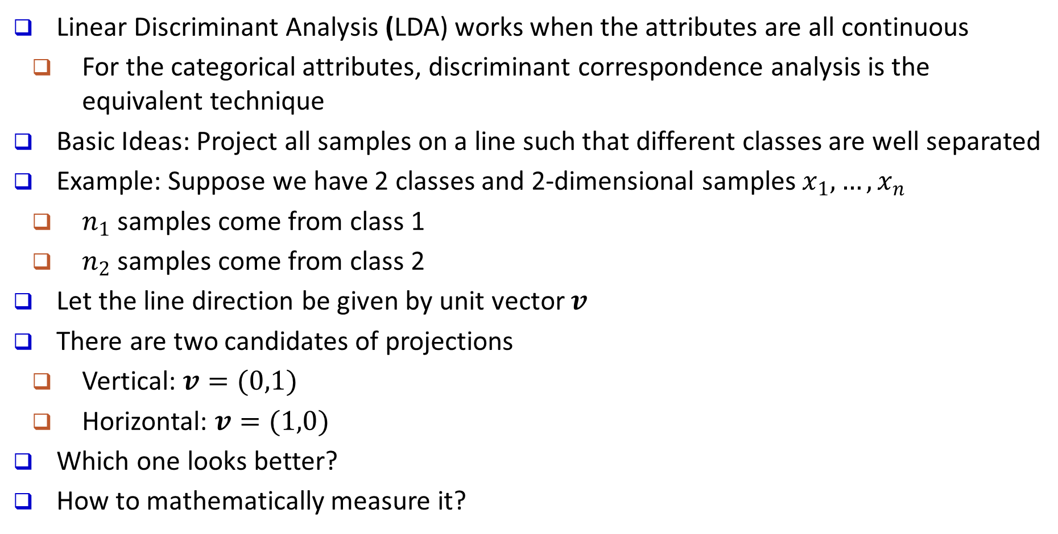
Linear Discriminant Analysis (LDA)
Linear Discriminant Analysis (LDA) works when the attributes are all continuous
For the categorical attributes, discriminant correspondence analysis is the equivalent technique
Basic Ideas: Project all samples on a line such that different classes are well separated
Example: Suppose we have 2 classes and 2-dimensional samples $x_{1},…,x_{n}$
$n_{1}$ samples come from class 1
$n_{2}$ samples come from class 2
Let the line direction be given by unit vector $v$
There are two candidates of projections
Vertical: $v=(0,1)$
Horizontal: $v=(1,0)$
Which one looks better?
How to mathematically measure it?

Slide 79
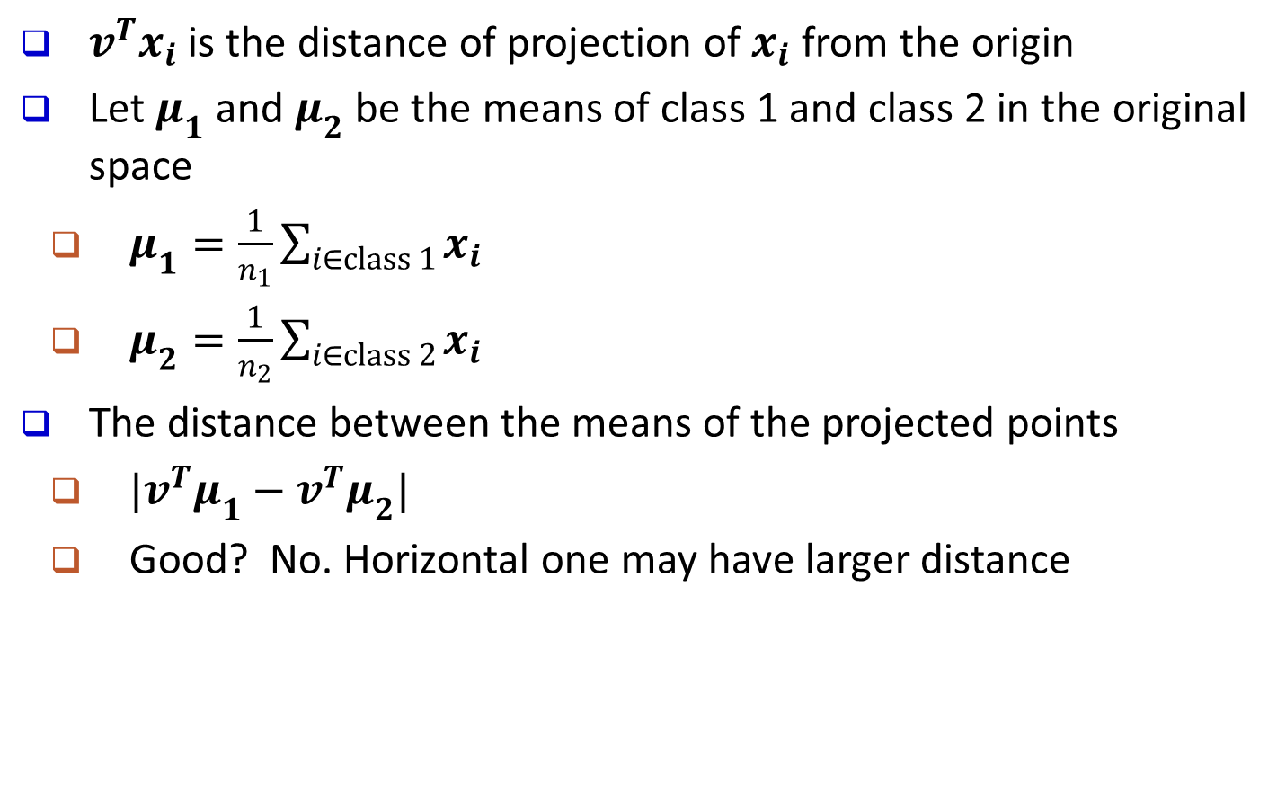
Fisher’s LDA (Linear Discriminant Analysis)
$v^{T}x_{i}$ is the distance of projection of $x_{i}$ from the origin
Let $μ_{1}$ and $μ_{2}$ be the means of class 1 and class 2 in the original space
$μ_{1}=\frac{1}{n_{1}}\sum_{i∈class 1}{x_{i}}$
$μ_{2}=\frac{1}{n_{2}}\sum_{i∈class 2}{x_{i}}$
The distance between the means of the projected points
$|v^{T}μ_{1}−v^{T}μ_{2}|$
Good? No. Horizontal one may have larger distance

Slide 80
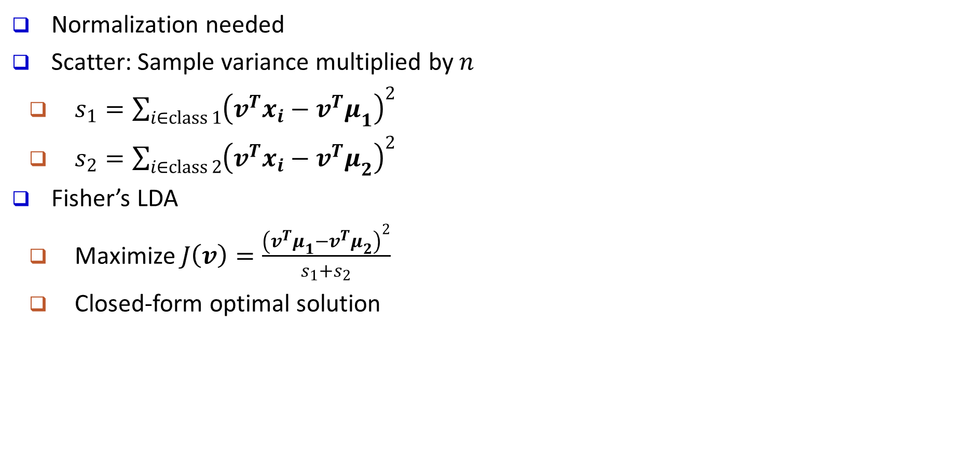
Fisher’s LDA (con’t)
Normalization needed
Scatter: Sample variance multiplied by $n$
$s_{1}=\sum_{i∈class 1}{{\left(v^{T}x_{i}−{v^{T}μ}_{1}\right)}^{2}}$
$s_{2}=\sum_{i∈class 2}{{\left(v^{T}x_{i}−v^{T}μ_{2}\right)}^{2}}$
Fisher’s LDA
Maximize $J\left(v\right)=\frac{{\left(v^{T}μ_{1}−v^{T}μ_{2}\right)}^{2}}{s_{1}+s_{2}}$
Closed-form optimal solution
Smaller Scatter
Bigger
Scatter

Slide 81
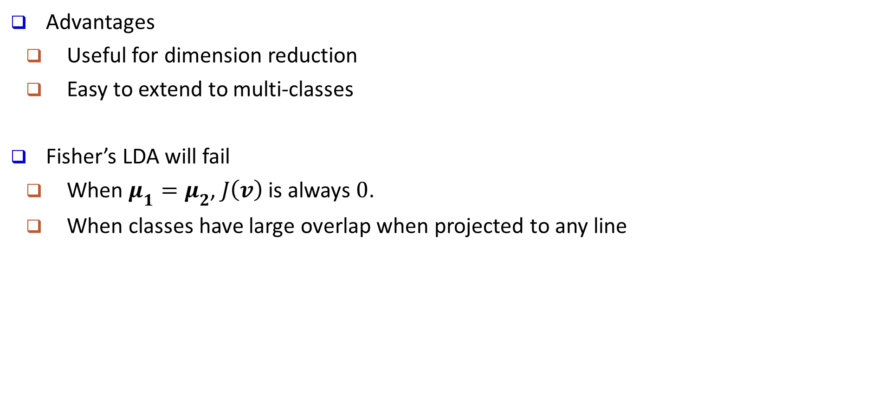
Fisher’s LDA: Summary
Advantages
Useful for dimension reduction
Easy to extend to multi-classes
Fisher’s LDA will fail
When $μ_{1}=μ_{2}$, $J\left(v\right)$is always $0$.
When classes have large overlap when projected to any line

